Slide 1
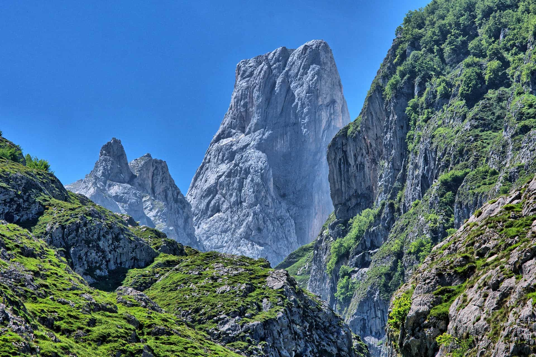

Spain
A Guide for Tourists

Slide 2
Geography
In the extreme southwestern tip of Europe
Spain is the 4th largest country in Europe
Among the 50 largest countries in the world
Spain is located in the Mediterranean region
Lends to hot dry summers and cool winters

Slide 3
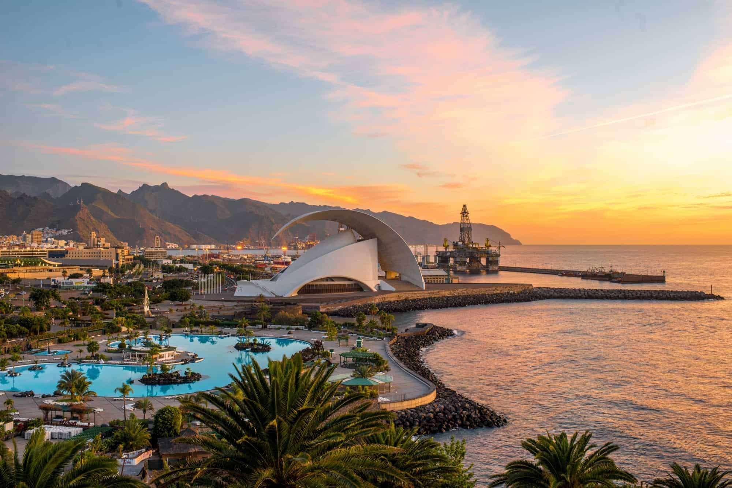
Geography
From its plateaus to snow-capped mountains Spain is diverse
Full of lively cities, Spain is the epicentre of culture
Spain has a group of Islands
Canary islands and the party island of Ibiza being the most popular

Slide 4
History
Spain is a very influential country
Spain has had different owners throughout history
From Christians, Muslims, The English and the Romans
Roman architecture still remains today
In the form of Aqueducts, Road systems and Theatres
Notes:
-Spain is very influential country in terms of its historical/social/artistic impact on the world.
- Spanish history is filled with different owners taking and shaping the country from the Visigoths, Christians, Muslims, The English, and the French. Spain has had its fair share of rulers.
The Romans arrived in Spain in 200BC and occupied it for over 600 years but took them at least 200 years to defeat the toughest tribes
Perfectly preserved roman architecture still remains. We can track the influence of roman architecture to our buildings today

Slide 5
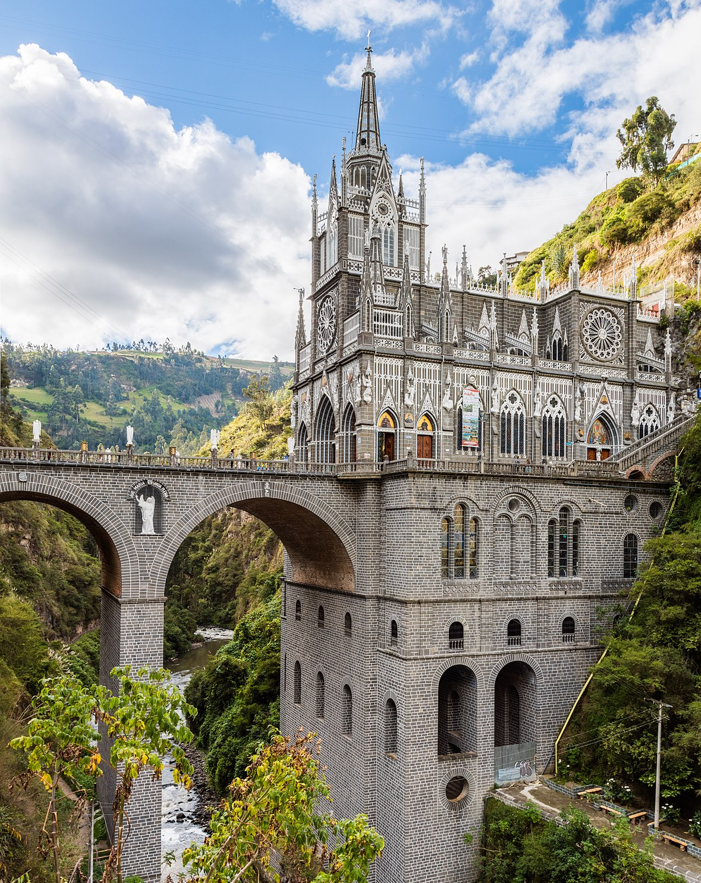
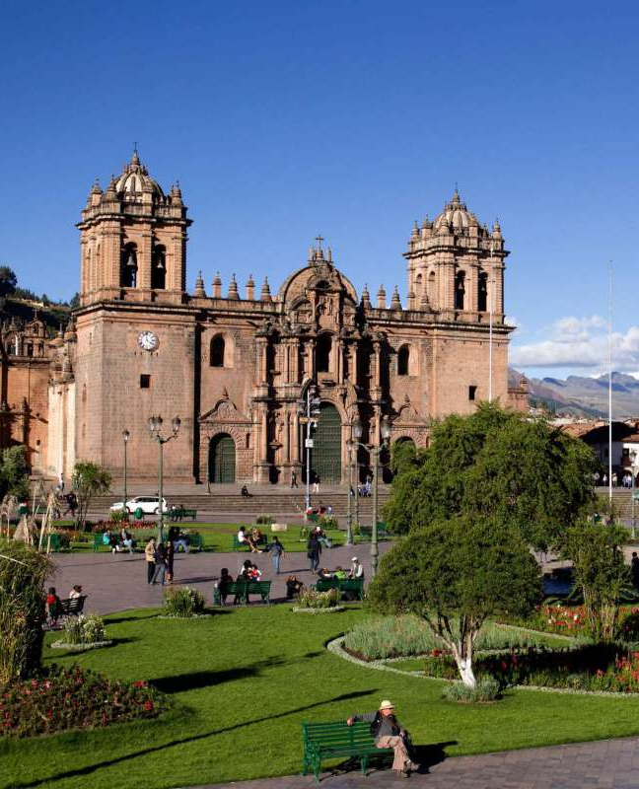
History
Spain funded Columbus’s discovery of the Americas
Spain influenced: Mexico, South America and the Caribbean
Spain influenced the worlds language and religion
Notes:
- In the year 1492, An Italian explorer “Christopher Columbus” discovered a new route to the New World. Funded by Queen Isabella the first.
This discovery kickstarted European interest into the new world. The Spanish empire is considered one of the greatest in this era solely due to the vast influence they brought
They conquered: majority of South America, the Caribbean, Mexico and the Majority of the United States
Spain brought Spanish to the New World and to date there are close to half a billion people speaking Spanish making it the 2nd most spoken language in the world after Manadarin

Slide 6
Government and Politics
Spain is a constitutional monarchy
Monarch power stripped in 1978
3 distinct branches of government
Famous leaders include:
Philip II
Hernan Cortes – Conquistador
Francis Xavier – Missionary
Notes:
Spain is a constitutional monarchy. Which means the ruling monarchs act as a ceremonial head of state
The current government system has been in place ever since the great transition the period of time when the fascist leader Francisco Franco took power to the monarchs in 1978
Philip II: King of Spain (1556-1598), Became king of England and Ireland and attempted to overthrow Elizabeth the first
Hernan Cortes: Conquered the Aztec Empire and the majority of Mexico
Francis Xavier: Famous Catholic missionary who preached from South Asia to East Asia

Slide 7
Government and Politics
Some political parties include:
Vox – Nationalist
PSOE – Socialist
Spain comprised of 17 autonomous regions
Madrid is the capital city
Financial centre & home of Real Madrid

Slide 8
Economy
Spain has the 14th largest economy in the world
Majority of GDP sourced from:
Finance
Tourism
Manufacturing
Barcelona has a large industrial region

Slide 9
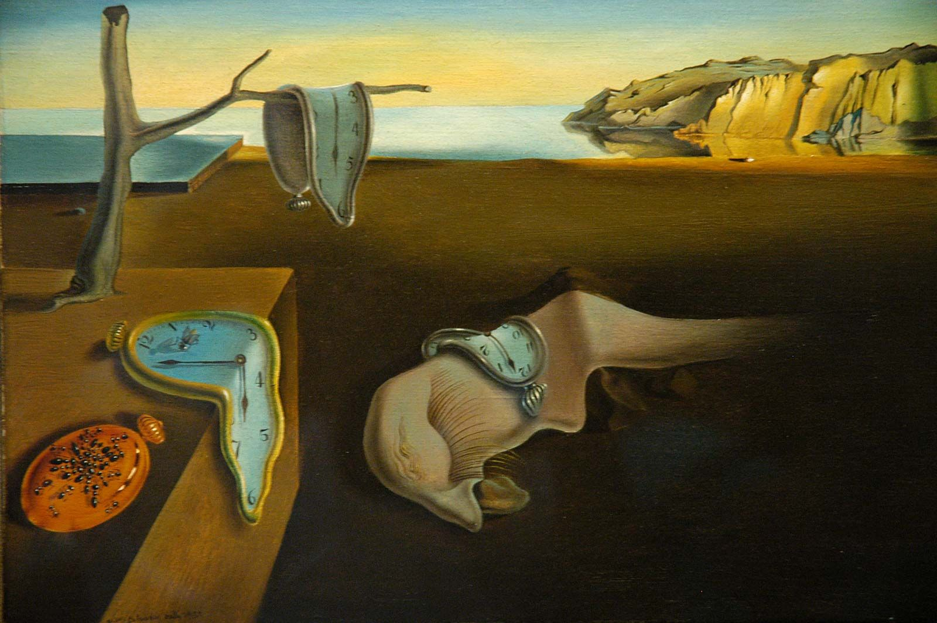
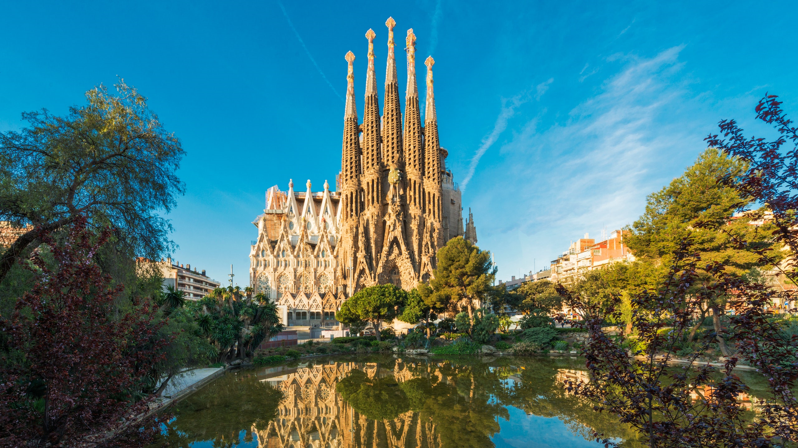
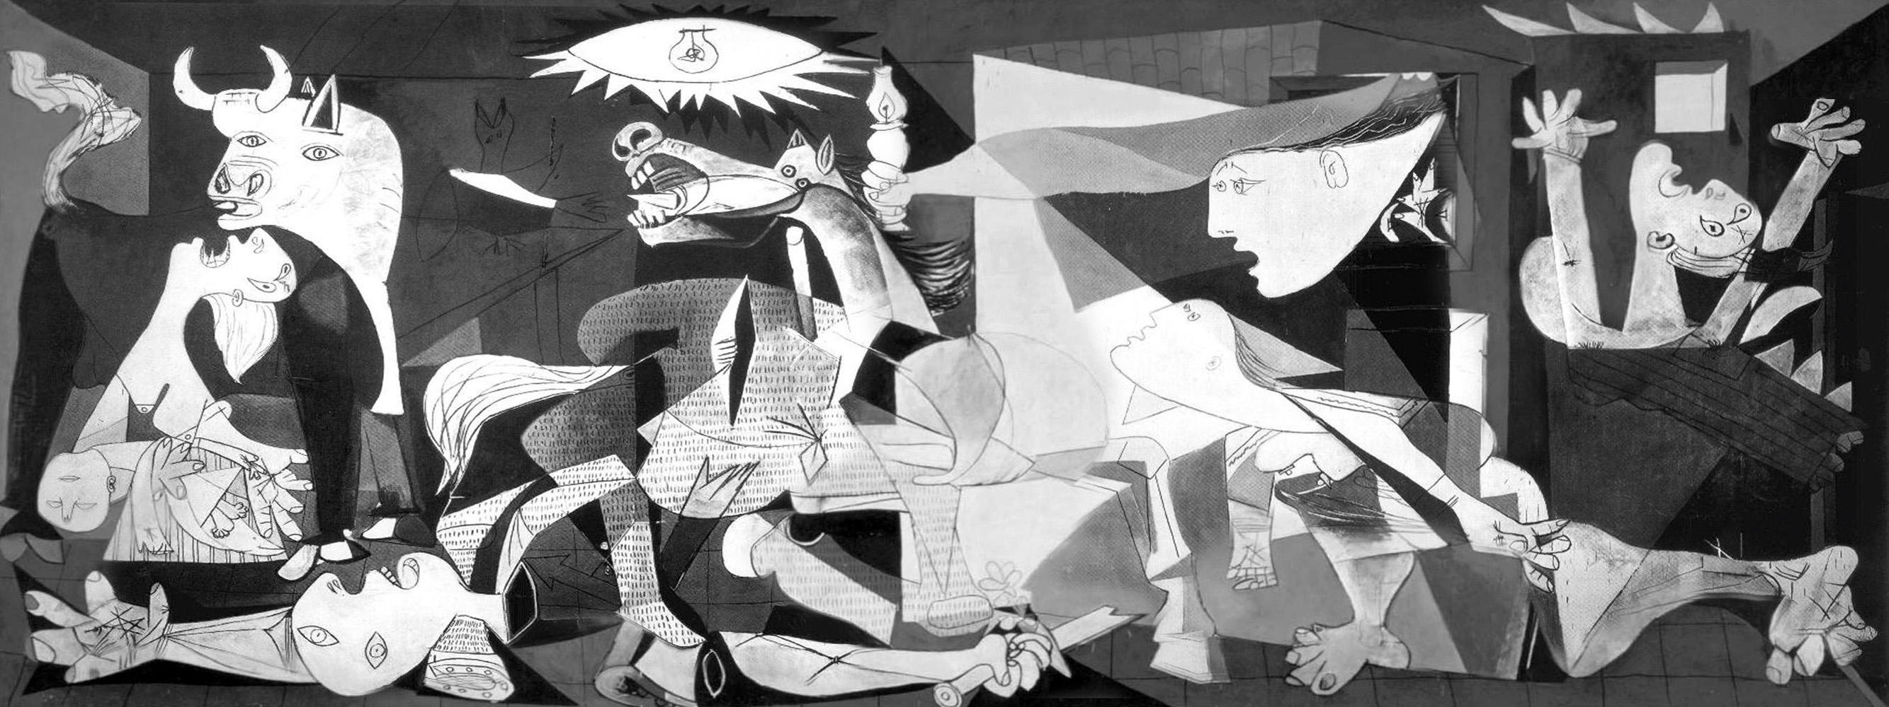
Famous People
Spain has had some of the most influential people in history
Pablo Picasso – Artist
Rafeal Nadal – Tennis Player
Salvador Dali – Artist
Antoni Gaudi – Architect
Notes:
Pablo Picasso – The infamous 20th century artist who is best known for his works such as “Gurenica” and “Les Demoiselles d’Avignon”
Rafael Nadal – Considered to be one of the best tennis players of all time
Salvador Dali – Yet another famous artist. He is best known for his bizarre style of paintings.
Antoni Gaudi – A well known architect, Known for his intricate architecture he is best known for the church of the sacred family

Slide 10
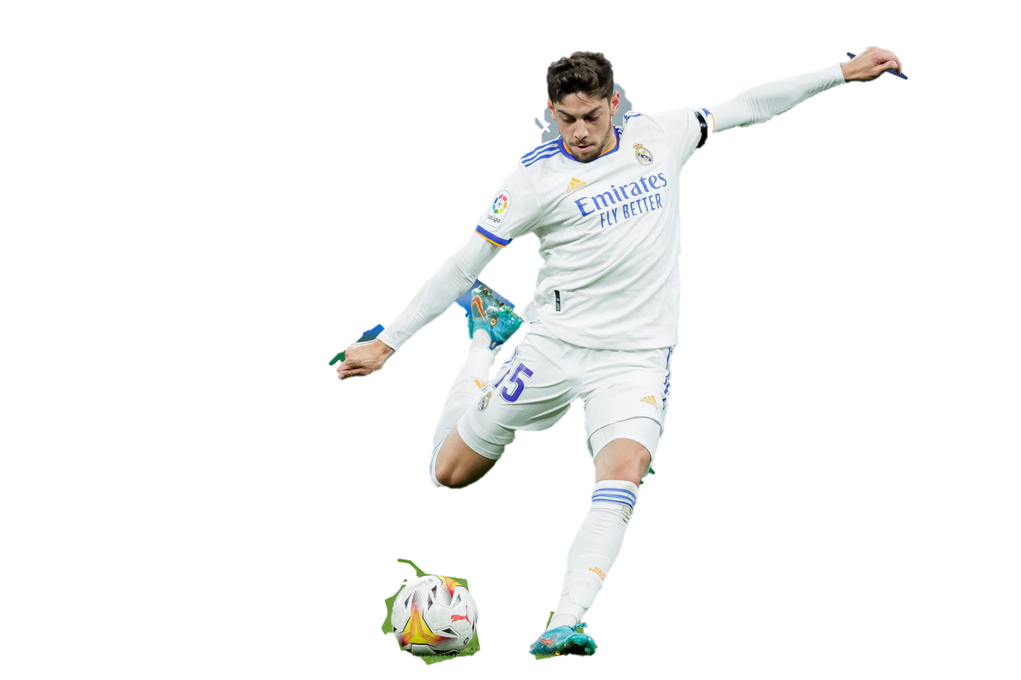
Demographics
5th Most populous European country
European Spanish is the main language
National sport: Football
Bullfighting is a integral part of Spanish culture
Religion | Percentage of Pop
Roman Catholic | 67.4%
Non Religious | 15.6%
Atheist | 12.2%
Islam | 4%
Other | 0.08%

Slide 11
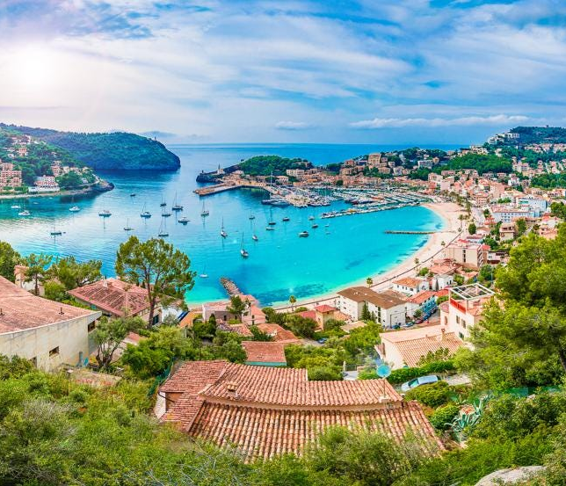
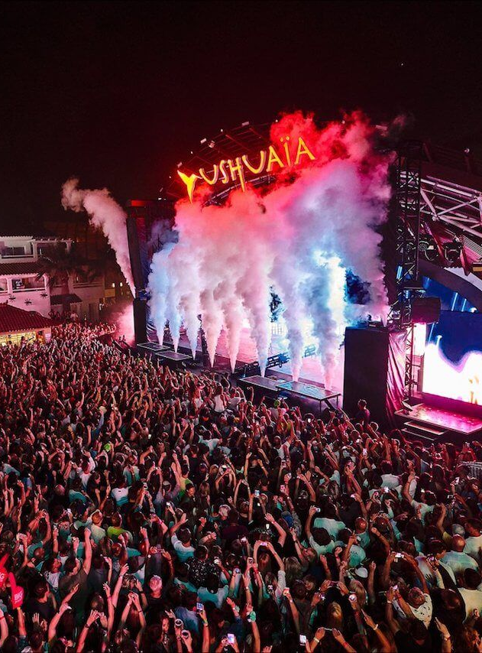
Personal Recommendations
Visit the Balearic Islands
Consists of:
Ibiza – Clubbing Capital of the World !
Formentera – More relaxed
Mallorca – Crown Jewel of the Mediterranean
Menorca – Family Friendly
Notes:
When you come to Spain
Ibiza is known worldwide for the abundance and variety of different clubs keeping the party going on no matter what time of day
Formentera is known as Ibizas little sister and is known for being much more laid back and perfect for couples !
Mallorca is the most popular tourist destination in the meditterranean. Consists of coves, limestone mountains, wineries among other attractions
Menorca is the most beautiful of the bunch. From its beautiful beaches to the meadows filled with wild flowers. The super laid back atmosphere of this island is perfect for families with children

Slide 12
Personal Recommendations
Visit the Church of the Sacred Family
Started in 1882, Still ongoing
Designed by Antoni Gaudi
Known for its intricate designs and sheer size it’s a must see

Slide 13
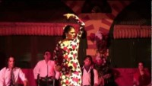
Personal Recommendations
Attend a Flamenco show
Symbol of Spain’s identity
Features song, dance and guitar music
Created by the Roma people but uniquely Andalusian

Slide 14
Spain is the:
Quiz
2nd Largest Country in Europe
3rd Largest Country in Europe
5th Largest Country in Europe
4th Largest Country in Europe
Quiz about geography

Slide 15
Answer: Question 1
Spain is the 4th Largest Country in Europe

Slide 16
Spain discovered the New World:
Quiz
True
False
Quiz about history

Slide 17
Answer: Question 2
False.
Spain FUNDED Columbus’s exploration of the New World

Slide 18
Spain has the:
Quiz
4th Biggest Economy in the World
11th Biggest Economy in the World
9th Biggest Economy in the World
14th Biggest Economy in the World
Quiz about economy

Slide 19
Answer: Question 3
Spain has the 14th Largest Economy worldwide

Slide 20
The Following are Spanish EXCEPT:
Quiz
Pablo Picasso
Guillermo Del Toro
Salvador Dali
Antoni Gaudi
Quiz about famous people

Slide 21
Answer: Question 4
Guillermo Del Toro is not Spanish.
He is a Mexican Director responsible for films such as:
Pans Labyrinth
Pacific Rim
Hellboy

Slide 22
Spains National Sport Is:
Quiz
Football
Lacrosse
Baseball
Basketball
Quiz about demographics

Slide 23
Answer: Question 5
Spains national sport is Football

Slide 24
Bibliography
Birthday?, C. B. (n.d.). Famous People of Spain. Retrieved from https://www.thefamouspeople.com/spain.php
Fiestas, S. (n.d.). History of Spain. Retrieved from Spanish Fiestas: https://www.spanish-fiestas.com/history/
Freedom, I. o. (2022). Spain. Retrieved from Index of Economic Freedom: https://www.heritage.org/index/country/spain
Harrison, R. J. (2022, Feb 13). Spain. Retrieved from Brittanica: https://www.britannica.com/place/Spain#ref70257
Karacs, S. (2021, October 1). The government and political system in Spain. Retrieved from Expatica: https://www.expatica.com/es/living/gov-law-admin/spain-government-106928/
Pariona, A. (2014, June 14). The Major Religions In Spain. Retrieved from World Atlas: https://www.worldatlas.com/articles/religion-in-spain.html
Rodriguez, V. (2022, February 13). Spain. Retrieved from Encyclopædia Britannica: https://www.britannica.com/place/Spain
TheFamousPeople. (n.d.). Famous Spanish Leaders. Retrieved from Celebrities Born On My Birthday?: https://www.thefamouspeople.com/spanish-leaders.php
Inserted a video, With style adjustments and made it so it plays when the presenter is clicking for the next bullets

